Slide 1


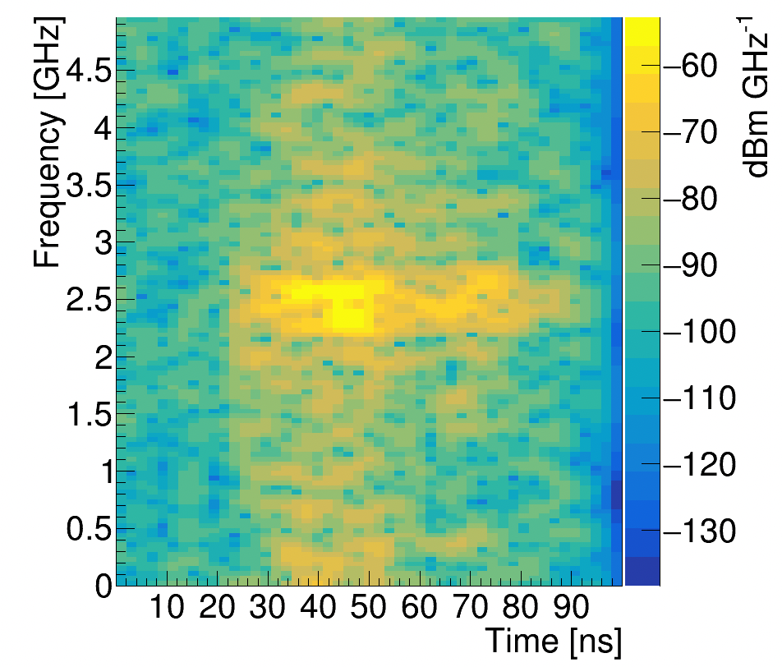
Neutrino Radar Gun
Richard Moser, working under Dr. Dave Besson
Objectives
Long term: Detect Ultra High Energy Neutrinos in Antarctic ice sheets via active radar sounding.
Effectively this means creating a radar speed trap for relativistic subatomic particles
Short term: Construct a test pulser for the Radio Echo Telescope group
Will be used to send out a simulated radar return signal to test receiver antennas
Can a given receiver antenna design even ”see” a radar return in the ice?
Image(s) here with caption(s)
“Sir, you were going 6.706e8 in a 35”
Approach
Conducting simulated in-ice particle interactions in to determine quantitatively what a real-world radar return would look like.
Utilizing a software package called Radio Scatter
Built in C++ and ROOT
Calculates radio reflections with respect to transmitter and receiver geometries, gain, transmission power, etc
Allows for quick changes to the above settings for testing prior to constructing and deploying physical sensors in Antarctica
October 2021

